Slide 1
Standard Template Library - II
by
Tenneti Venkata Suresh(159231)
Foundation TEG
18 November 2013

Slide 2
Associative Containers
Associative Containers
  Containers that are ordered and the elements of which have a relationship between them.
Map : A key/value pair; the key serves as an index into the map; and the value serves as the data to be stored and retrieved.
Set : A collection of elements that are unique.
  As the elements are unique, they act as a key themselves.
Multimap and multiset allow multiple occurrences of key to be stored.

Slide 3
Maps & Sets
#include <map> for using the map and multimap classes.
#include <set> for using the set and multiset classes.
Maps and sets are typically implemented as binary search trees.
Elements in the sets cannot be modified (are always const). They can only be inserted or removed.
Maps support the direct access operator (operator[]).
Refer programs maps.cpp and sets.cpp

Slide 4
Container Adaptors
Container adaptors
  Classes/objects that hold other container objects and provide a specific interface irrespective of underlaying container object
      stack < vector<int> > intStackObj1; // best choice
      stack < list<int> > intStackObj2; // bad choice

Slide 5
Stacks
Operation | Function
empty() | returns true if the stack is empty; false otherwise.
size() | returns a count of the number of elements on the stack.
pop() | removes, but does not return, the top element from the stack.
top() | returns, but does not remove, the top element on the stack.
push(item) | places a new top element on the stack.
Stack objects exhibit the Last-In-First-Out (LIFO) property.
#include <stack> // Refer program stacks.cpp
Remember to use both the top() and pop() functions to retrieve and remove the elements from the stack.

Slide 6
Queues
Operations | Function
empty() | returns true if the queue is empty; false otherwise.
size() | returns a count of the number of elements on the queue.
pop() | removes, but does not return, the front element from the queue.
front() | returns, but does not remove, the front element on the queue.
back() | returns, but does not remove, the back element on the queue.
push(item) | places a new element at the end of the queue.
Queue objects exhibit the First-In-First-Out (FIFO) property.
#include <queue> // Refer program Queues.cpp

Slide 7
Priority Queues
Operations | Function
empty() | returns true if the queue is empty; false otherwise.
size() | returns a count of the number of elements on the queue.
pop() | removes, but does not return, the front element from the queue.
front() | returns, but does not remove, the front element on the queue.
back() | returns, but does not remove, the back element on the queue.
push(item) | places a new element at the end of the queue.
Queue objects exhibit the First-In-First-Out (FIFO) property.
#include <queue> // Refer program Queues.cpp

Slide 8
Iterators
Insert iterators
  back_inserter() : causes the container's push_back() insert operation to be invoked. [Refer program Iterators.cpp]
  front_inserter() : causes the container's push_front() insert operation to be invoked.
  inserter() : causes the container's insert() insert operation to be invoked.
Reverse iterators traverse the elements in the opposite direction of the traversal of the normal iterators.

Slide 9
Iterators
Type of iterator | Function
Input iterator | Can be used in sequential input operations, where value of each element pointed to is read once and the iterator is incremented.
Output iterator | Used in sequential output operations, where each element pointed to is written a value once and the iterator is incremented
Forward iterator | Can be used to access the elements in a range from its beginning towards its end.
Bidirectional iterator | Can be used to access the elements in a range in both directions (towards the end and towards the beginning)
Random Access Iterator | Can be used to access elements at any arbitrary offset position. (Pointers are iterators of this category)

Slide 10
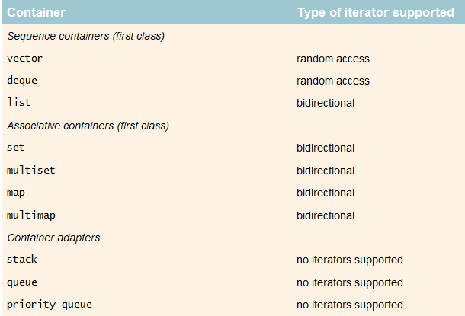
Iterators

Slide 11
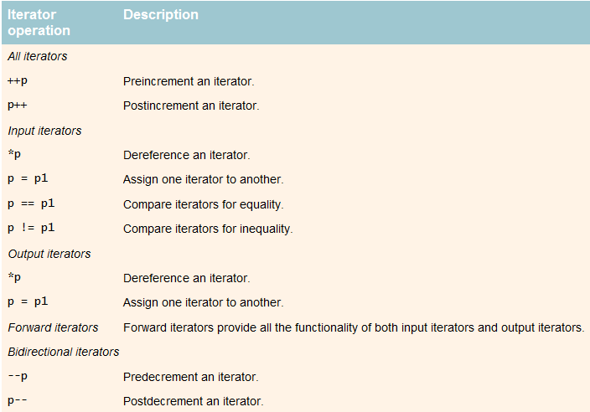
Operations on iterators

Slide 12
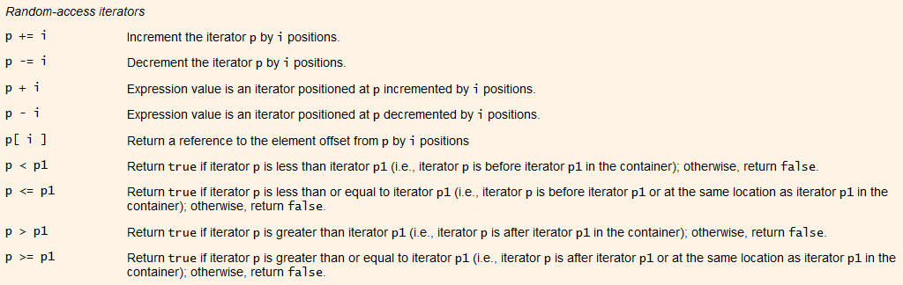
Operations on iterators

Slide 13
Algorithms
The container classes in the STL does not support the generic functionalities like min(), max(), find() and sort().
Such generic functions are implemented separately and are called as generic algorithms.
The generic algorithms operate not only on the containers of the STL but also on the arrays of built-in data types.
The algorithms cannot directly manipulate the containers but are associated with the containers only through the iterators.
It is the iterators that access the elements of the container and manipulate them. [ Refer program Algorithms.cpp ]

Slide 14
Algorithms
This approach helps algorithms achieve complete independence from the type of the container as they do not access the elements of the container.
Algorithms often return the iterators to the elements.
  For example: a search function returns an iterator to the element found.
Algorithms that use the weakest of iterators and more flexible as they can be used with any container.
Around 70 algorithms are implemented in the STL.
The trio of the Containers, Iterators and Algorithms hence form a well defined library for data.

Slide 15
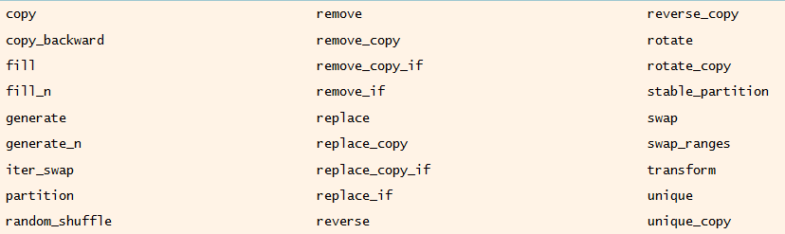
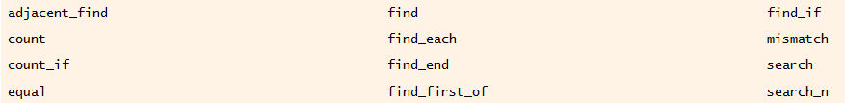
Algorithms

